Slide 1

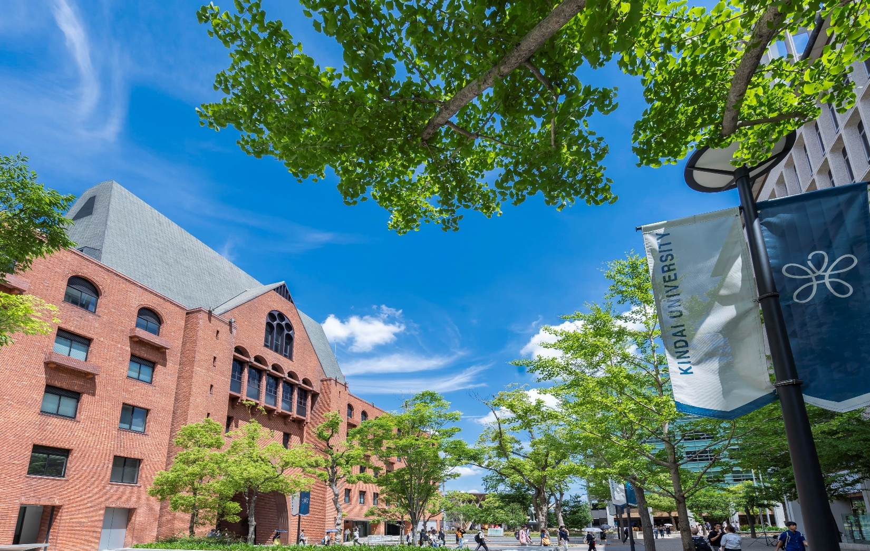
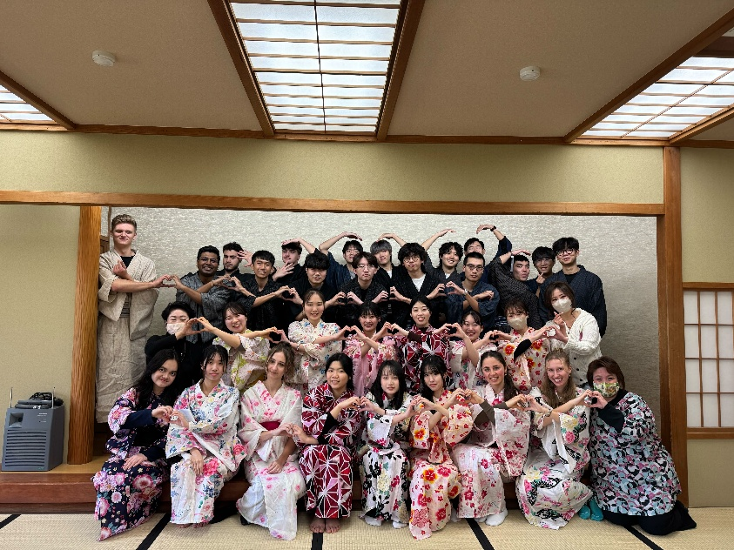
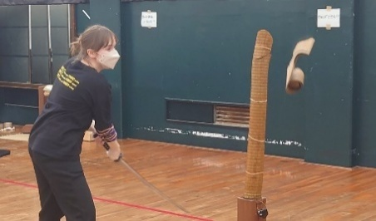
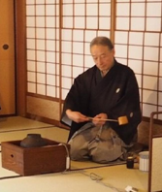
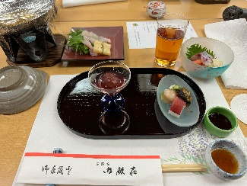
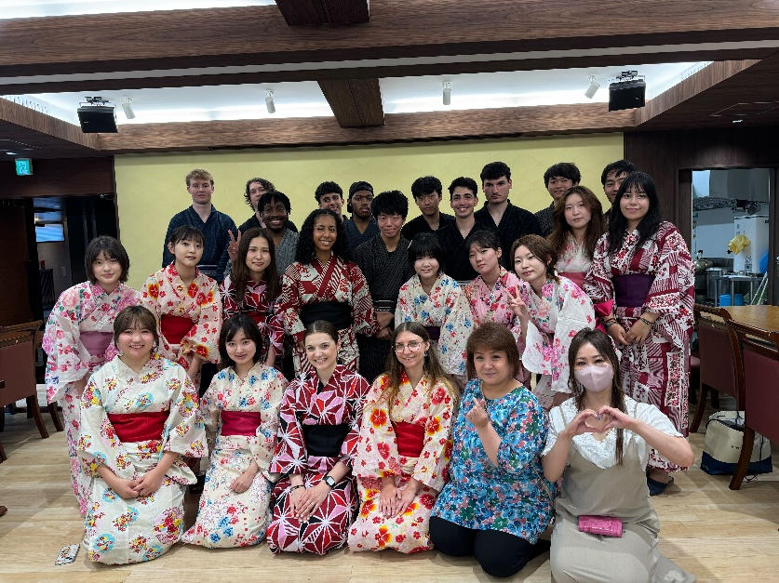
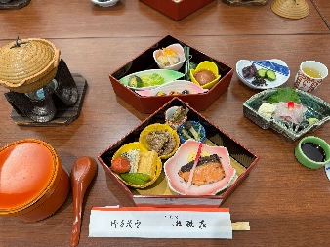

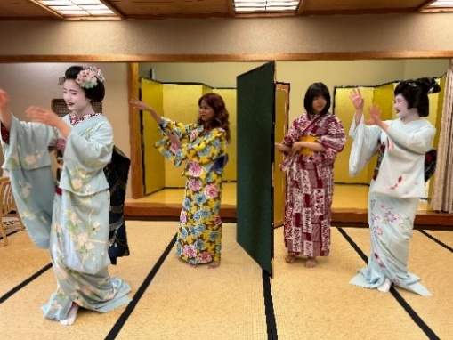
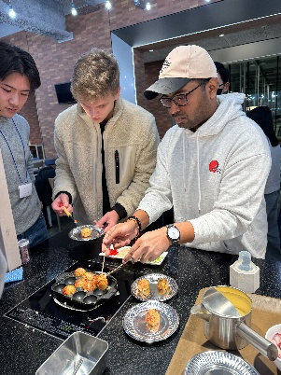
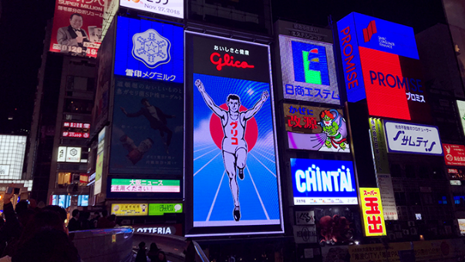
Kindai Short-Term
Japanese Program
Once in a Lifetime Experience
in Osaka!
* Images for illustration purposes only.
January 12 ～ January 29, 2027
<Application Period: October 2 ～ October 27, 2026>
Program Fee: \330,000
(incl. Accommodation, Airport pickup and Textbook)
*Check-In Date Choice: January 10 or 11, 2027
Check-Out Date (Fixed) : January 30, 2027
Contact
Kindai University Email: isc@itp.kindai.ac.jp
Global Education Center Tel: +81-6-4307-3081

Slide 2
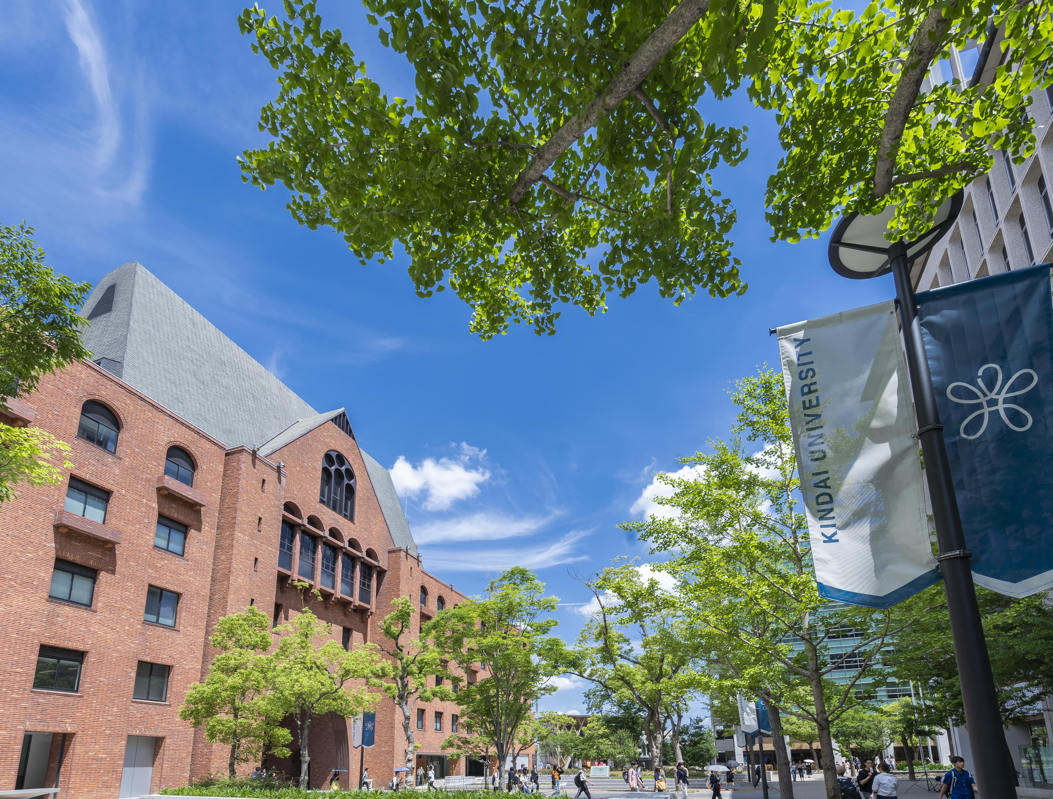

Program Description
Following contents are included in the Program Fee.
＊This program is non-credit. The certificate of completion is provided.
★Japanese Language Course with a text book - 34.5 hours (90 min x 23 classes) <Beginners-Intermediate Levels Only. No class for N1 holders.>
★Japanese Culture Experience (Once or twice a week, including one day trip to Iga)
★Interactions with Kindai students!
Hands-on!
Requirements
・Applicants must be enrolled as full-time students in an undergraduate or a graduate program at one of Kindai's partner universities through the entire program period.
・Applicants must not hold any residence status in Japan at the time of application and must join the program as a tourist.
・Applicants must be able to join ALL scheduled lectures and activities.
・Applicants should be able to understand English or Japanese at a basic conversational level in order to follow the extra cultural activities.
Application Process
Complete your application online via the Google Form below.
Please prepare the required information and documents before completing the application form.
Kindai Short-Term Japanese Program Application Form
Participant Capacity Min. 12 – Max. 30
* The program is cancelled if the number of applicants does not reach the minimum number of participant.
* The application will be closed once we reach the capacity of participants.
First-come and first- served basis!
First-come and first- served basis!

